Slide 1
Estimation of Software

Slide 2
Software project management
Project planning involves:
Project scope definition (WBS)
Software estimation (cost req.)
Software scheduling (time req.)
Network diagram & Gantt charts

Slide 3
Software project Estimation
Project Estimation is done on the basis of:
Project size
Project Cost
Effort required
Project duration

Slide 4
Metrics used for project size estimation
Lines of codes (LOC)
Functional points (FPs)

Slide 5


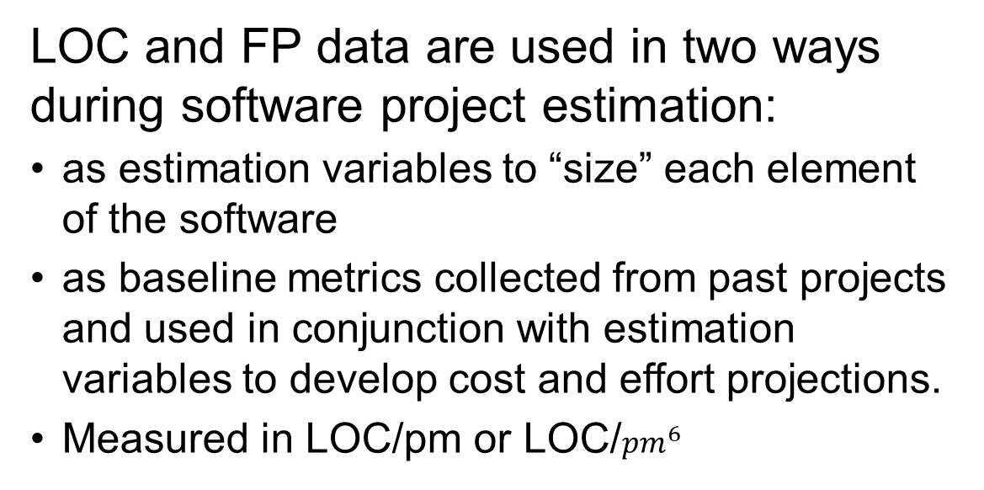
Software project estimation
LOC and FP data are used in two ways during software project estimation:
as estimation variables to “size” each element of the software
as baseline metrics collected from past projects and used in conjunction with estimation variables to develop cost and effort projections.
Measured in LOC/pm or LOC/${pm}^{6}$

Slide 6
Lines of Code estimation

Slide 7
LOC
Count every line of source code except blanks (improve code readability) or comments (improves code understandability).
Count each declaration, actual code containing logic and computations
Advantages:
Easy to count and calculate
Disadvantages:
Not a good metric for estimation as its highly dependent on the programming language used.

Slide 8
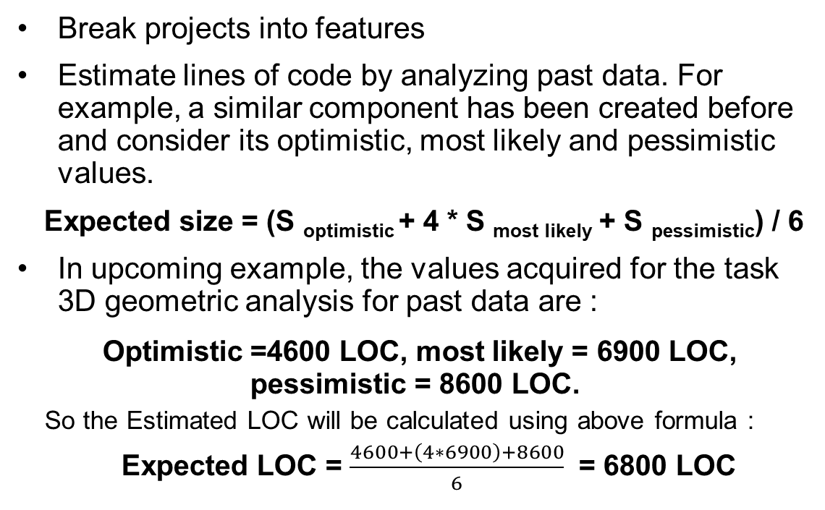
LOC
Break projects into features
Estimate lines of code by analyzing past data. For example, a similar component has been created before and consider its optimistic, most likely and pessimistic values.
Expected size = (S _{optimistic} + 4 * S _{most likely} + S _{pessimistic}) / 6
In upcoming example, the values acquired for the task 3D geometric analysis for past data are :
Optimistic =4600 LOC, most likely = 6900 LOC, pessimistic = 8600 LOC.
So the Estimated LOC will be calculated using above formula :
Expected LOC = $\frac{4600+\left(4∗6900\right)+8600}{6}$ = 6800 LOC

Slide 9
LOC based estimation example
The mechanical CAD software will accept two- and three-dimensional geometric data from an engineer.
The engineer will interact and control the CAD system through a user interface that will exhibit characteristics of good human/machine interface design.
All geometric data and other supporting information will be maintained in a CAD database.
Design analysis modules will be developed to produce the required output, which will be displayed on a variety of graphics devices.
The software will be designed to control and interact with peripheral devices that include a mouse, digitizer, laser printer, and plotter.

Slide 10
LOC based estimation example
Functions | Estimated LOC
2D geometric analysis | 5300
3D geometric analysis | 6800
UI and control facilities | 2300
Database management | 3350
Design analysis modules | 8400
Computer graphics display facilities | 4950
Peripheral control | 2100

Slide 11
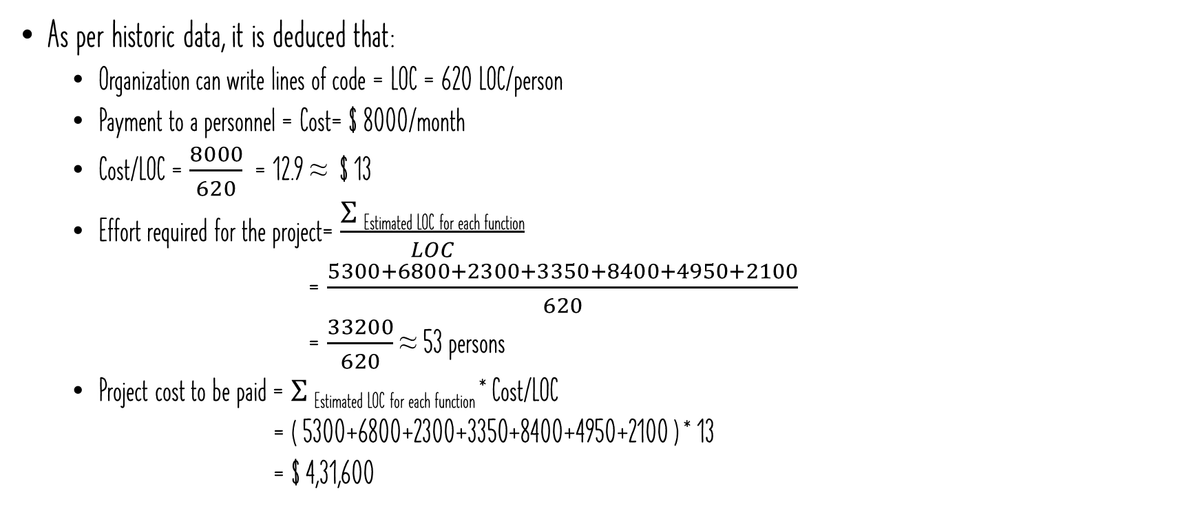
LOC based estimation example
As per historic data, it is deduced that:
Organization can write lines of code = LOC = 620 LOC/person
Payment to a personnel = Cost= $ 8000/month
Cost/LOC = $\frac{8000}{620}$ = 12.9 ≈ $ 13
Effort required for the project= $\frac{\text{Σ} \text{Estimated} \text{LOC} \text{for} \text{each} \text{function}}{LOC}$
= $\frac{5300+6800+2300+3350+8400+4950+2100}{620}$
= $\frac{33200}{620}$ ≈ 53 persons
Project cost to be paid = $\text{Σ} \text{Estimated} \text{LOC} \text{for} \text{each} \text{function}$* Cost/LOC
= ( 5300+6800+2300+3350+8400+4950+2100 ) * 13
= $ 4,31,600
A “person month” is the metric for expressing the effort (amount of time) personnel devote to a specific project. Approximately equals to 140 hours

Slide 12
Functional points estimation

Slide 13
FP estimation
Not a language dependent estimator
It measures functionality from a user’s point of view. Like what he/she received or entered to the system.
estimate inputs, outputs, inquiries, files and external
Here,
weight defines the importance and complexity of an operation (LMS would have more I/O operations, phone directory will have more files and searching operations)

Slide 14
Identify functional points
Find the number of functions belonging to the following types:
External Inputs: Functions related to data entering the system.
External outputs: Functions related to data exiting the system.
External Inquiries: They leads to data retrieval from system but don’t change the system.
Internal Files: a user identifiable group of logically related data that resides entirely within the application boundary and is maintained through External Inputs. Log files are not included here.
External interface Files: These are logical files for other applications which are used by our system.

Slide 15
FP Estimation
To compute functional points;
FP=UFP * CAF
where UFP = unadjusted functional points, CAF = complexity adjustment factor
Now calculate UFP, where each FP is ranked as per complexity. Predefined weights for each category is given in next table.

Slide 16
FP Estimation
Measurement parameter | Counts | Low | Average | High | =count * weighting factor
External inputs |  | 3 | 4 | 6
External outputs |  | 4 | 5 | 7
External enquired |  | 3 | 4 | 6
Internal logic files |  | 7 | 10 | 15
External interface files |  | 5 | 7 | 10
Count total
Low, average and high are weighting factors. Anyone is selected depending on complexity of the measurement parameter.

Slide 17
FP Estimation
Calculate CAF
CAF = 0.65 +(0.01 * Σ Fi )
Where, Fi is the value adjustment factor depends on the reply to following 14 questions.

Slide 18
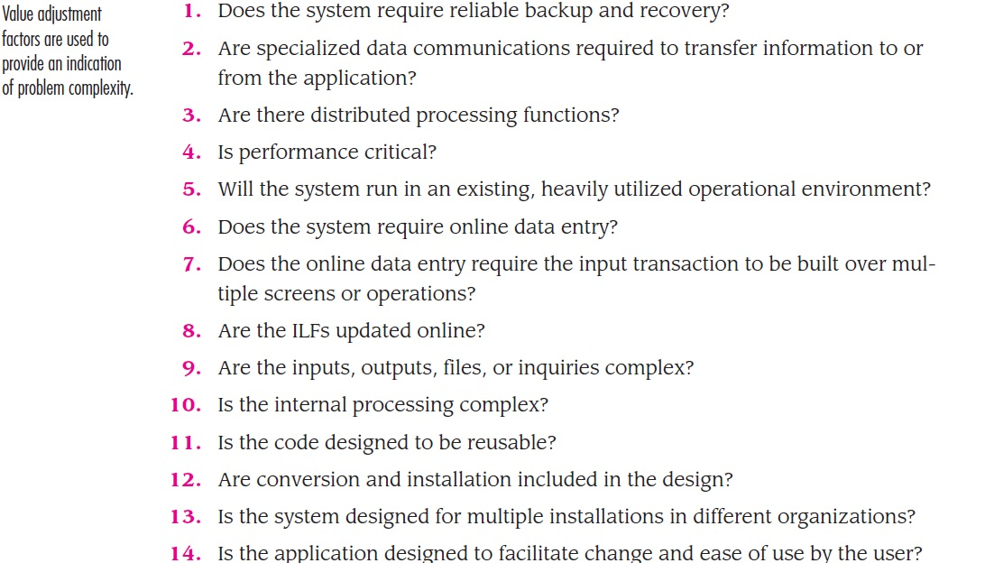
FP Estimation
These questions value may vary from 0 to 5, where
0= not important
1= incidental (that values depends on an activity)
2= moderate
3= average
4= significant
5=essential

Slide 19
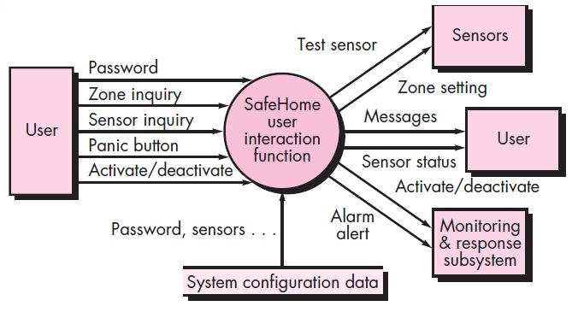
FP based estimation example
a set of key information domain measures required for computation of the function point metric.
external inputs: password, panic button, and activate/deactivate.
External outputs: messages and sensor status
external inquiries: zone inquiry and sensor inquiry.
ILF: system configuration file
EIFs: test sensor, zone setting, activate/deactivate, and alarm alert

Slide 20

FP based estimation Example
Measurement parameter | Counts | Low | Average | High | =count * weighting factor
External inputs | 3 | 3 | 4 | 6 | 9
External outputs | 2 | 4 | 5 | 7 | 8
External enquired | 2 | 3 | 4 | 6 | 6
Internal logic files | 1 | 7 | 10 | 15 | 7
External interface files | 4 | 5 | 7 | 10 | 20
Count total |  |  |  |  | 50
Calculate for low complexity

Slide 21
FP based estimation Example
Calculate CAF
CAF = 0.65 +(0.01 * Σ Fi )
Lets say, the product is moderately complex product, so all 14 questions answered in moderate form
i.e. 2
Σ Fi = 14*2 =28
CAF = 0.65 + ( 0.01 * 28) =0.93
FP = UFP * CAF
FP = 50 * 0.93 = 46.5

Slide 22
FP based estimation
If lets say team productivity is 60FP/person-week, then
Effort = FP/productivity
= FP/60
If team size =5, then
Project duration = Effort/ team size
= Effort/5 weeks

Slide 23
FP based estimation
Assume that past data indicates:
1 FP translates into 60 lines of code (an object-oriented language is to be used)
and that 12 FPs are produced for each person-month of effort.
These historical data provide the project manager with important planning information that is based on the requirements model rather than preliminary estimates.
Assume further that past projects have found:
an average of three errors / function point during requirements and design reviews
four errors / function point during unit and integration testing.
These data can ultimately help you assess the completeness of your review and testing activities.

Slide 24
FP based estimation Example 2
User input = 55
User outputs = 35
User enquiries = 40
User files = 8
External interfaces =5
Calculate FP = UFP * CF

Slide 25

FP based estimation Example 2
Measurement parameter | Counts | Low | Average | High | =count * weighting factor
External inputs | 55 | 3 | 4 | 6 | ?
External outputs | 35 | 4 | 5 | 7 | ?
External enquired | 40 | 3 | 4 | 6 | ?
Internal logic files | 8 | 7 | 10 | 15 | ?
External interface files | 5 | 5 | 7 | 10 | ?
Count total |  |  |  |  | = ?
Calculate for high complexity

Slide 26
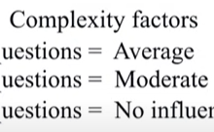
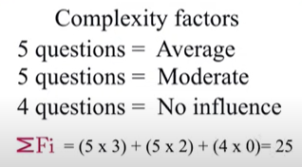
FP based estimation Example
Calculate CAF
CAF = 0.65 +(0.01 * Σ Fi )
Lets say, the product is significantly complex product so all 14 questions answered in moderately form i.e. 4
Σ Fi = ? (if complexity factor is differing for each FP then calculate separately.)
CAF = 0.65 + ( 0.01 * ? ) = ?
FP = UFP * CAF
FP = ? * ? = ?

